Slide 1
JAVASCRIPT
The language that drives the web

Slide 2
JAVASCRIPT
🔹 JavaScript is the most popular programming language according to research (e.g., RedMonk, Stack Overflow surveys). 👉 Frontend – HTML/CSS manipulation, animations, UI/UX improvements. 👉 Backend – Node.js allows JavaScript to run on servers. 👉 Mobile apps – React Native allows you to develop mobile apps using JavaScript.
🔹 Java vs JavaScript? – They have about as much in common as the emperor (car) and carpet. 🔹 JavaScript is an interpreted language – It is executed line by line in the browser. 🔹 Java is a compiled language – It is first compiled into an executable file, then it is run. 🔹 Why "Java" in JavaScript? – In the 90s, the name Java was popular, so Netscape took advantage of that popularity.
Notes:
Teacher Notes:
Highlight JavaScript’s ubiquity: front‑end (DOM manipulation, animations), back‑end with Node.js, and cross‑platform mobile with React Native.
Contrast interpreted (JS) vs. compiled (Java) languages and explain why JS was named for marketing in the 90s.

Slide 3
Resources:
MDN Web Docs – Introduction to JavaScript
“State of JS” survey results (e.g. RedMonk & StackOverflow)
Additional Reading:
Eloquent JavaScript by Marijn Haverbeke
You Don’t Know JS (book series) by Kyle Simpson ​
https://github.com/rwaldron/idiomatic.js – JAvascript code convetion.

Slide 4
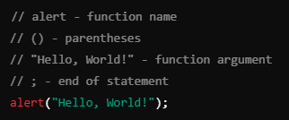
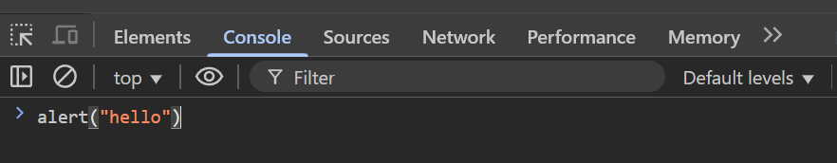
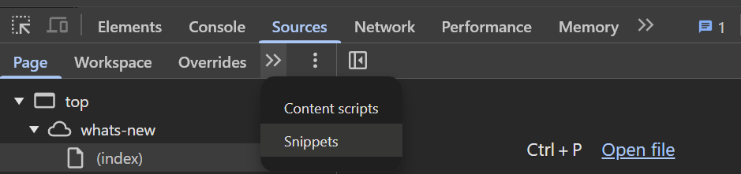
JAVASCRIPT – FIRST STEPS
👉 We can use double ("") or single ('') quotation marks for text. 👉 Recommendation: Double quotes for text data in JavaScript. 👉 Developers should follow the same writing styles for readability.
Notes:
Teacher Notes:
Discuss coding styles: single versus double quotes, semicolon usage, naming conventions.
Recommend adopting a style guide (Airbnb, Google) and using linters (ESLint).
Resources:
Airbnb JavaScript Style Guide – github.com/airbnb/javascript
ESLint – eslint.org

Slide 5
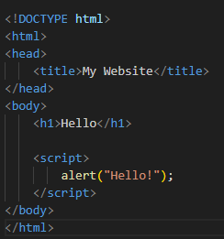
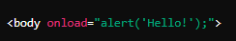
JAVASCRIPT – INTEGRATION
Intern Javascript
Inline Javascript
👉 Bad practice! 👉 Difficult to maintain and debugging. 👉 It's inseparable from HTML.
👉 Better than inline JavaScript, but still not optimal for larger projects.
Notes:
Teacher Notes:
Inline: <button onclick="…"> – quick tests but poor maintainability.
Internal: <script> in the page head/body – central per‑page, but duplicates across pages.
External: <script src="app.js" defer> – best practice for caching and separation of concerns; explain defer/async.

Slide 6
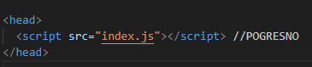
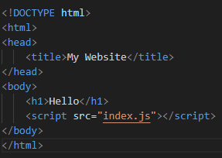
JAVASCRIPT – INTEGRATION
Extern Javascript
👉 The JavaScript will run before the HTML is loaded. 👉 If the script tries to change HTML elements that have not yet been loaded, we will get an error.
👉 Better code organization 👉 Easier maintenance 👉 Better performance 👉 Allows caching, which speeds up page loading 👉 The page works faster by displaying the content first, then running javascript

Slide 7
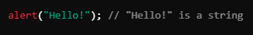
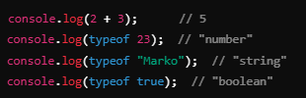
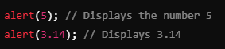
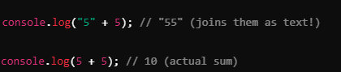
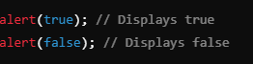
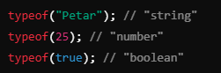
JAVASCRIPT – INTEGRATION
Exercise
👉 String
👉Numbers
👉 Boolean (true/false)
👉 They allow us to use the data in the program correctly. 👉 They prevent errors – we cannot, for example, add a string and a number:
👉 How the browser recognizes
Notes:
Teacher Notes:
Cover primitive types (String, Number, Boolean, null, undefined, Symbol, BigInt) and Objects.
Demonstrate type coercion pitfalls ('5' + 2 === '52' vs. 5 + +'2' === 7).

Slide 8
Resources:
MDN Web Docs – JavaScript data types and data structures
JavaScript Info – Types, values, objects
MDN Web Docs – <script> element
Google Developers – Loading JS Efficiently
Additional Reading:
You Don’t Know JS: Types & Grammar by Kyle Simpson

Slide 9
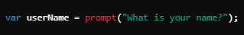
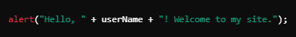
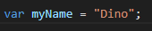
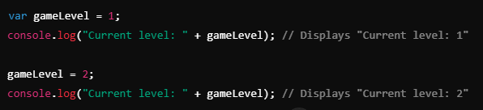
JAVASCRIPT – VARIABLE
👉They allow data to be reused without repeating the code. 👉 They help organize the program. 👉 They allow you to customize and change data during program execution.
Exercise
👉 Declaration
👉 Change in value
Notes:
Teacher Notes:
Introduce var, let, and const. Recommend defaulting to const, then let for reassignable variables.
Show examples of redeclaration and scope differences in a live REPL.
Resources:
MDN Web Docs – var, let, and const
JavaScript Info – Let and Const

Slide 10
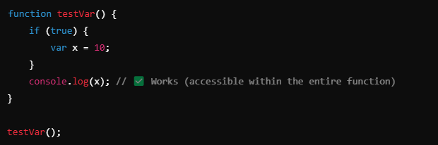
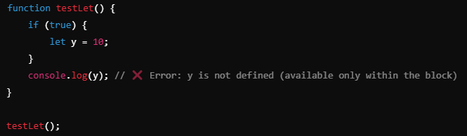
JAVASCRIPT – VARIABLE
VAR
LET
👉Variables defined using var are available within the entire function in which they are declared, even before the declaration itself.
👉Variables defined using let are only available within the block {} in which they are defined.
Notes:
Teacher Notes:
Explain function vs. block scope. Demonstrate Temporal Dead Zone (TDZ) when accessing let/const before declaration.
Show how var is hoisted with an example.
Resources:
MDN Web Docs – Scope
JavaScript Info – Hoisting

Slide 11
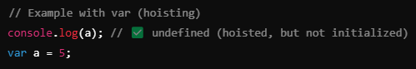
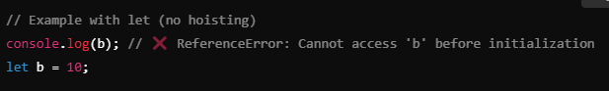
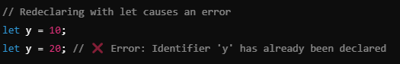
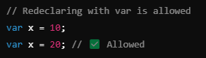
JAVASCRIPT – VARIABLE
VAR
LET
👉VAR is "hoisted" to the top of its function, but initialized as undefined.
👉let is also raised, but it is not initialized, so if you access it before declaring, you get a ReferenceError.
👉VAR allows the same variable to be redeclared within the same scope.
👉let does not allow re-declaration within the same scope.

Slide 12
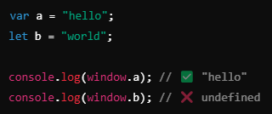
JAVASCRIPT – VARIABLE NAMING
VAR
LET
👉VAR becomes a property of the window object.
👉let it doesn't.
💡Use let instead of var to better control the reach and avoid unexpected behavior due to hoisting.

Slide 13
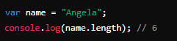

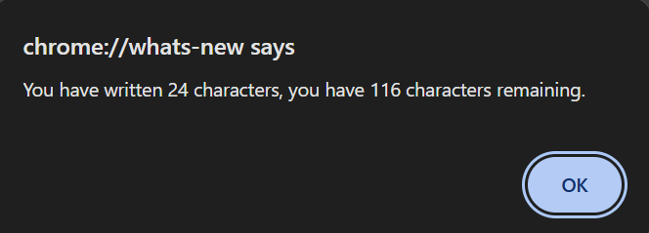
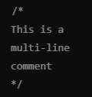
JAVASCRIPT – LENGTH
👉length tells us how many characters a string has. 👉Useful for checking character limits (e.g. for tweets)
Exercise
Write a code that: ✔ It allows the user to enter text. ✔ Calculates the number of characters. ✔ Shows how many characters are left (max: 140).
Code commenting
Notes:
Teacher Notes:
Use str.length to enforce limits (e.g., Twitter‐style 140‑character checks).
Walk through a prompt/alert exercise that counts remaining characters.
Resources:
MDN Web Docs – String.prototype.length

Slide 14
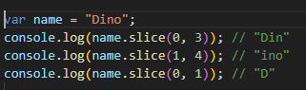
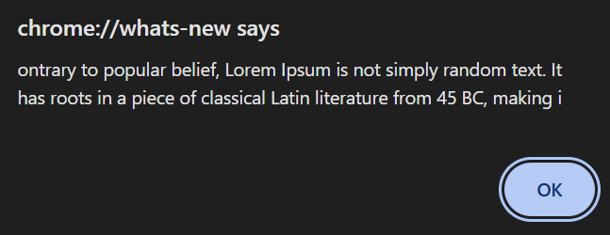
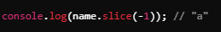
JAVASCRIPT – SLICE
👉slice(start, end) takes the part of the string from start to end (not including end). 👉 It is useful for limiting entries (e.g. the number of characters in a tweet)
Exercise
Write a code that: ✔ It allows the user to enter text. ✔ Shorten text to 140 characters. ✔ Display shortened text using alert().
👉Example of how to draw the last character
Notes:
Teacher Notes:
Demonstrate slice(start, end), including negative indices, to truncate text.
Build on the length exercise by slicing text over 140 characters and displaying via alert().
Resources:
MDN Web Docs – String.prototype.slice()

Slide 15
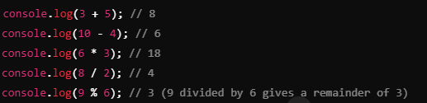
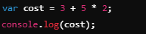
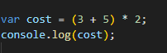
JAVASCRIPT – MATHEMATICS
Mathematicians operators
Exercise
Write a code that: ✔ 1. Prompt input from the user using prompt(). ✔ 2. Calculate the human years according to the formula. ✔ 3. Display the result using alert().
Sequence of operations
👉First, multiplication * and division / are performed, then addition + and subtraction -. ✔ 👉 If we want to change the order, we use parentheses ().
Notes:
Teacher Notes:
Review +, -, *, /, % and the default precedence; show how parentheses alter evaluation.
Example exercise: prompt user for input (e.g., dog years → human years formula) and alert() result.
Resources:
MDN Web Docs – Arithmetic operators
Additional Reading:
Programming JavaScript Applications by Eric Elliott

Slide 16
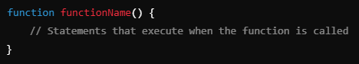
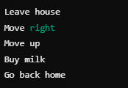
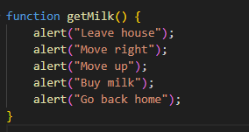
JAVASCRIPT – FUNCTIONS
👉We use it to avoid repeating the code. 👉 We call her only when we need her
Exercise
Write a code that: ✔ 1. Returns the text shown below as a log instead of an aler
Notes:
Teacher Notes:
Define a function with function name(params){…} and explain DRY (Don’t Repeat Yourself).
Exercise: replace an alert() with console.log() via a simple function call.
Resources:
MDN Web Docs – Functions

Slide 17
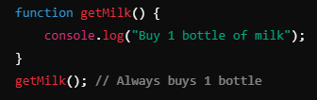
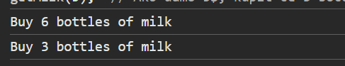
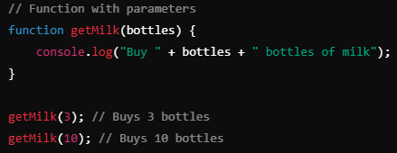
JAVASCRIPT – FUNCTIONS
👉 Parameters allow a function to receive input and use it within its code 👉 Without parameters, the function always works the same – with parameters we can change its outcome!
Exercise
✔ The function should receive the amount of money. ✔ Calculates how many bottles of milk you can buy (1 bottle = $1.5). ✔ It shows how many bottles he can buy.
Notes:
Teacher Notes:
Show how parameters make functions reusable (e.g., calculate bottles of milk at $1.50 each).
Distinguish side‑effect functions (no return) vs. pure functions (with return value).
Resources:
MDN Web Docs – Function parameters
MDN Web Docs – return

Slide 18
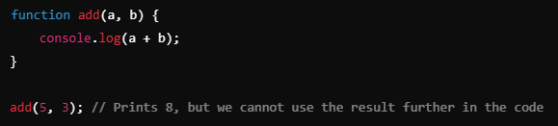

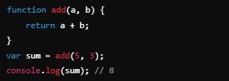
JAVASCRIPT – FUNCTIONS
👉 Return allows the function to return a value that can be used later. 👉 The No Return function performs an action, but does not return any result.
Exercise
✔ The function receives the amount of money. ✔ Calculates how many bottles of milk he can buy (1 bottle = $1.5). ✔ Returns change (money left over after purchase).

Slide 19
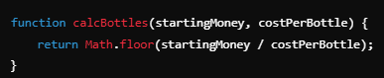
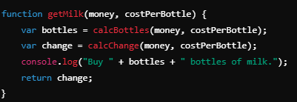
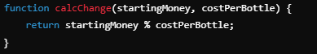
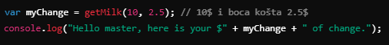
JAVASCRIPT – FUNCTIONS
💡By combining multiple functions, we improve the organization of the code!

Slide 20
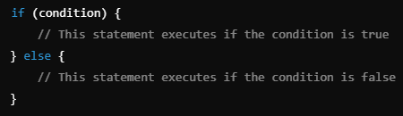
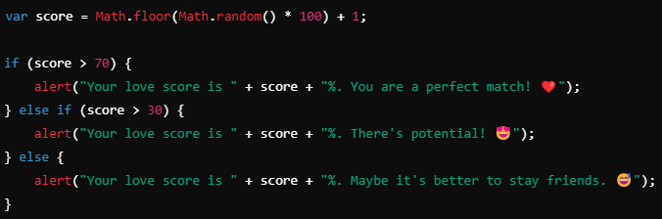
JAVASCRIPT – CONDITIONS
One condition
Multiple conditions
👉 Conditions allow you to control the flow of the program 👉 We can create advanced logics
Notes:
Teacher Notes:
Conditions: if / else, switch for control flow.
Comparators: === vs. ==, <, >, etc., and pitfalls of coercion.
Logical Operators: &&, ||, !, short‑circuit behavior for defaults.
Resources:
MDN Web Docs – Control flow and error handling
MDN Web Docs – Comparison operators
Additional Reading:
Effective JavaScript by David Herman
You Don’t Know JS: Types & Grammar by Kyle Simpson

Slide 21
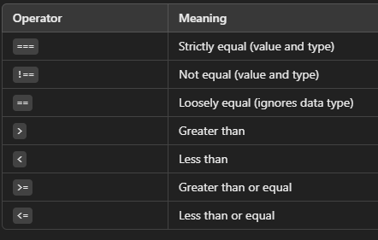
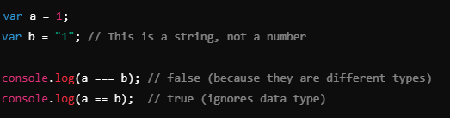
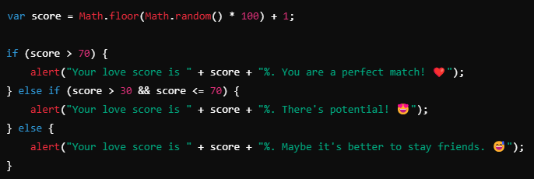
JAVASCRIPT – COMPARATORS
👉 Always use === for precise checks
💡By combining comparison operators, we can make more complex logic.

Slide 22




JAVASCRIPT – LOGICAL OPERATORS
👉 Logical operators allow you to check multiple conditions at once.

Slide 23

JAVASCRIPT – DOM
Document object model
👉 DOM is a website model that allows JavaScript to modify HTML and CSS in real-time. 👉 When the page loads, the browser converts HTML into a DOM object that we can select and manipulate.
Notes:
Teacher Notes:
Explain how the browser parses HTML into a tree of nodes that JS can traverse and manipulate.
Show document global and basic node types (Element, Text, Comment).
Resources:
MDN Web Docs – Introduction to the DOM
Additional Reading:
DOM Enlightenment by Cody Lindley

Slide 24

JAVASCRIPT – DOM
👉 Allows you to change HTML elements (text, color, content...) 👉 Interaction with the user (clicks, typewriter, input fields...) 👉 Automate changes without refreshing the page
Notes:
Teacher Notes:
Demonstrate selecting elements via getElementsByTagName or querySelectorAll.
Exercise: select the third <li> and change its text to your name without editing the HTML.
Resources:
MDN Web Docs – Document.querySelectorAll()

Slide 25



JAVASCRIPT – DOM
Exercise
✔ Select the third <li> element and change its text to your name (WITHOUT changing the HTML)!
👉Changing HTML Elements
👉changing CSS styles
👉simulates click na checkbox.

Slide 26



JAVASCRIPT – DOM
Exercise
✔ Change the color of the Google link using JavaScript
💡querySelector() and querySelectorAll() are the most powerful because they can select IDs, classes, and tags at the same time.
Notes:
Teacher Notes:
Cover querySelector() for complex CSS‑style selectors.
Exercise: change the color of a “Google” link dynamically via JS.
Resources:
MDN Web Docs – Element.querySelector()

Slide 27

JAVASCRIPT – FINAL EXERCISE
Add JavaScript functionality to the existing EduHence Classroom Management website. The goal is to add dynamic behavior to the form and table so that students can interact with the site.
Task Instructions:
Add Dynamic Form Handling:
Create a JavaScript function that adds a new student to the table when the form is submitted.
After submission, the form fields should clear automatically.
Add Delete Button:
Add a delete button next to each student in the table.
When the delete button is clicked, the student should be removed from the table.
Add Filtering:
Add a search input that allows students to filter the table by student name.
The table should update dynamically as the user types.
Validation:
Ensure that the form fields are filled before adding a new student.
Display an alert or error message if the form is incomplete.
Update on GitHub:
Once you’ve added the functionality, commit and push the updated code to your GitHub repository.
Notes:
Teacher Notes:
Set clear requirements: dynamic form handling, delete buttons, live filtering, input validation, and GitHub deployment.
Encourage use of event listeners (addEventListener), DOM updates (appendChild, removeChild), and basic error handling.
Resources:
MDN Web Docs – Introduction to events
freeCodeCamp – JavaScript DOM Manipulation Projects
Additional Reading:
You Don’t Know JS: Async & Performance by Kyle Simpson
Professional JavaScript for Web Developers by Nicholas C. Zakas
CODE - https://github.com/dinoDuvnjak/CTK/tree/main/SHIFT4IT/javascript-introduction/4.1-final-exercise

